Slide 1



3.3.1
Test for Significance of Residuals
Presented by Ritu Raj Pradhan
23908

Slide 2
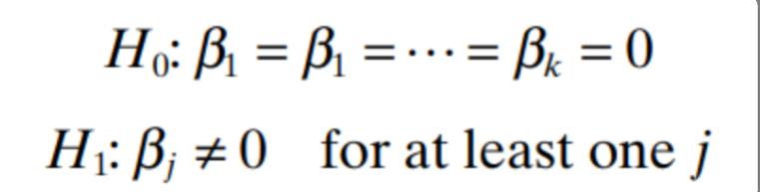
We test this using the following Hypothesis:

Slide 3
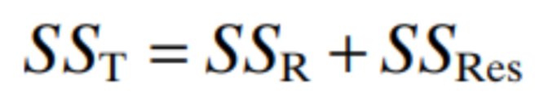
The test procedure is a generalization of the analysis of variance used in simple linear regression. The total sum of squares SST is partitioned into a sum of squares due to regression , SSR , and a residual sum of squares , SSRes

Slide 4
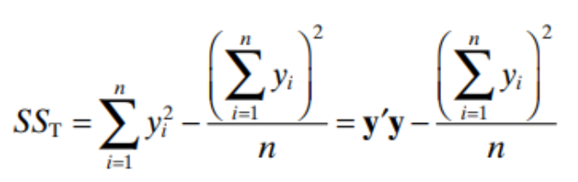
Now, we know, SST can be calculated as:

Slide 5
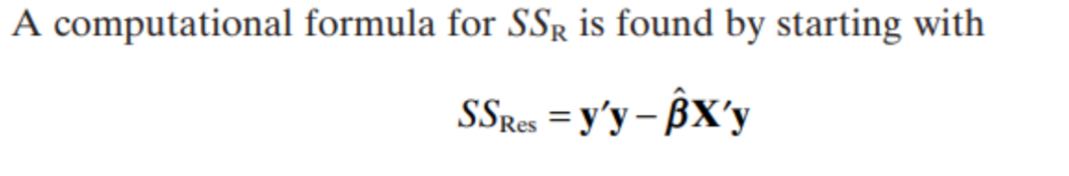
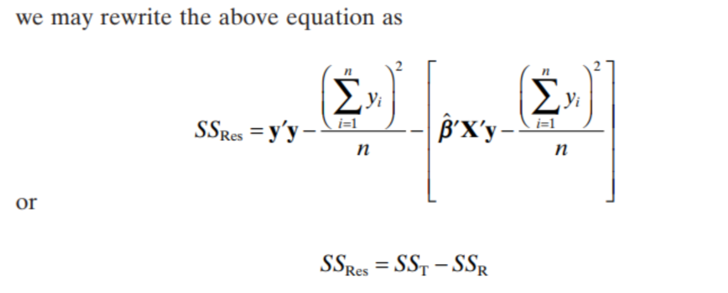
And SSr can also be calculated as:
This can be manipulated by adding and subtracting:

Slide 6
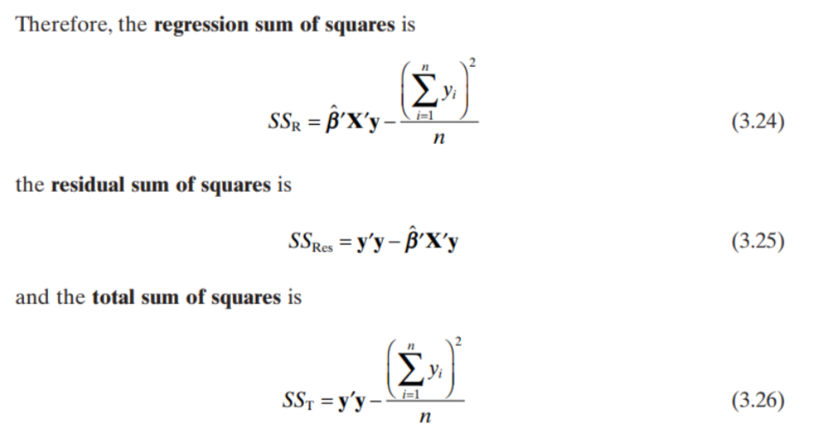
Therefore, we are left with the formulae for the residuals:

Slide 7
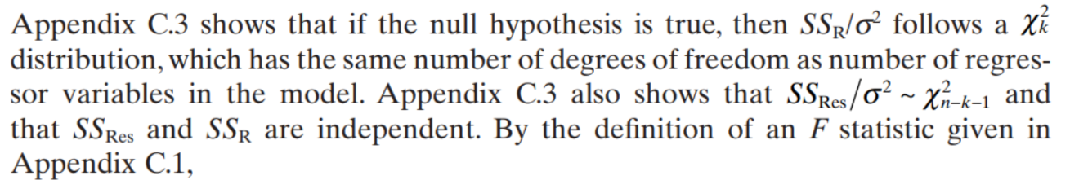
With this, we can formulate our test statistic::

Slide 8
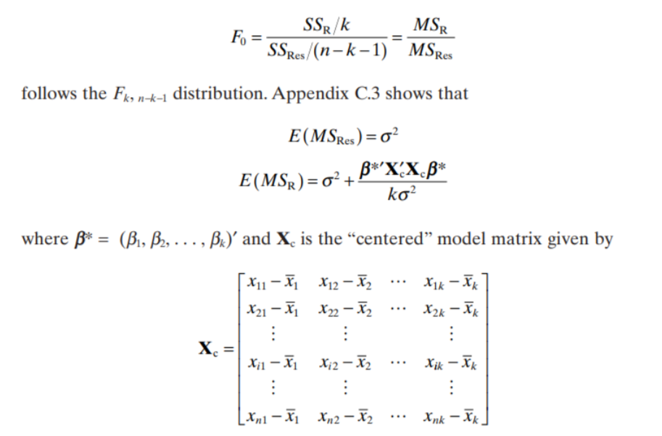

Slide 9
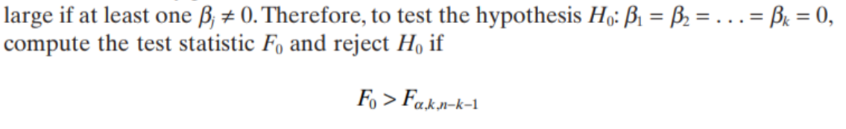
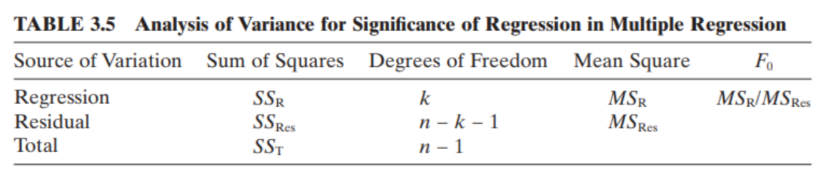
And just like in Simple Linear Regression, we have out ANOVA table as:

Slide 10

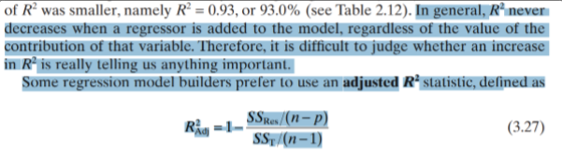

Slide 11
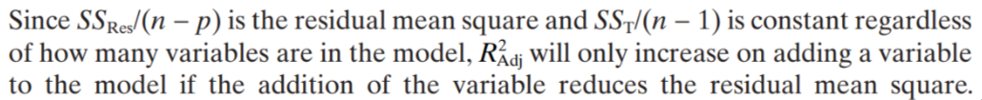

Slide 12
Thank You
Jai Sairam

